Slide 1

Project Presentation Software Engineering 2
PowerEnJoy – Project Presentation
PowerEnJoy
Share. Be Green. Enjoy!
Team members: Giovanni Scotti – Marco Trabucchi
Professor: Luca Mottola
A.Y. 2016/2017
POLITECNICO DI MILANO

Slide 2

Introduction
PowerEnJoy – Project Presentation
Known Issues and numbers:
5 documents and about 200-250 pages.
About 150 hours per team member to draw up the decuments.
We will do our best in order to introduce the complexity of our project.
IDEA and APPROACH of the presentation:
We discuss the main features and functionalities of our system-to-be, also using examples and real usage scenarios.
The order we follow to describe the documents is the one given by the Waterfall Model – a sequential design process used in software development.
POLITECNICO DI MILANO

Slide 3
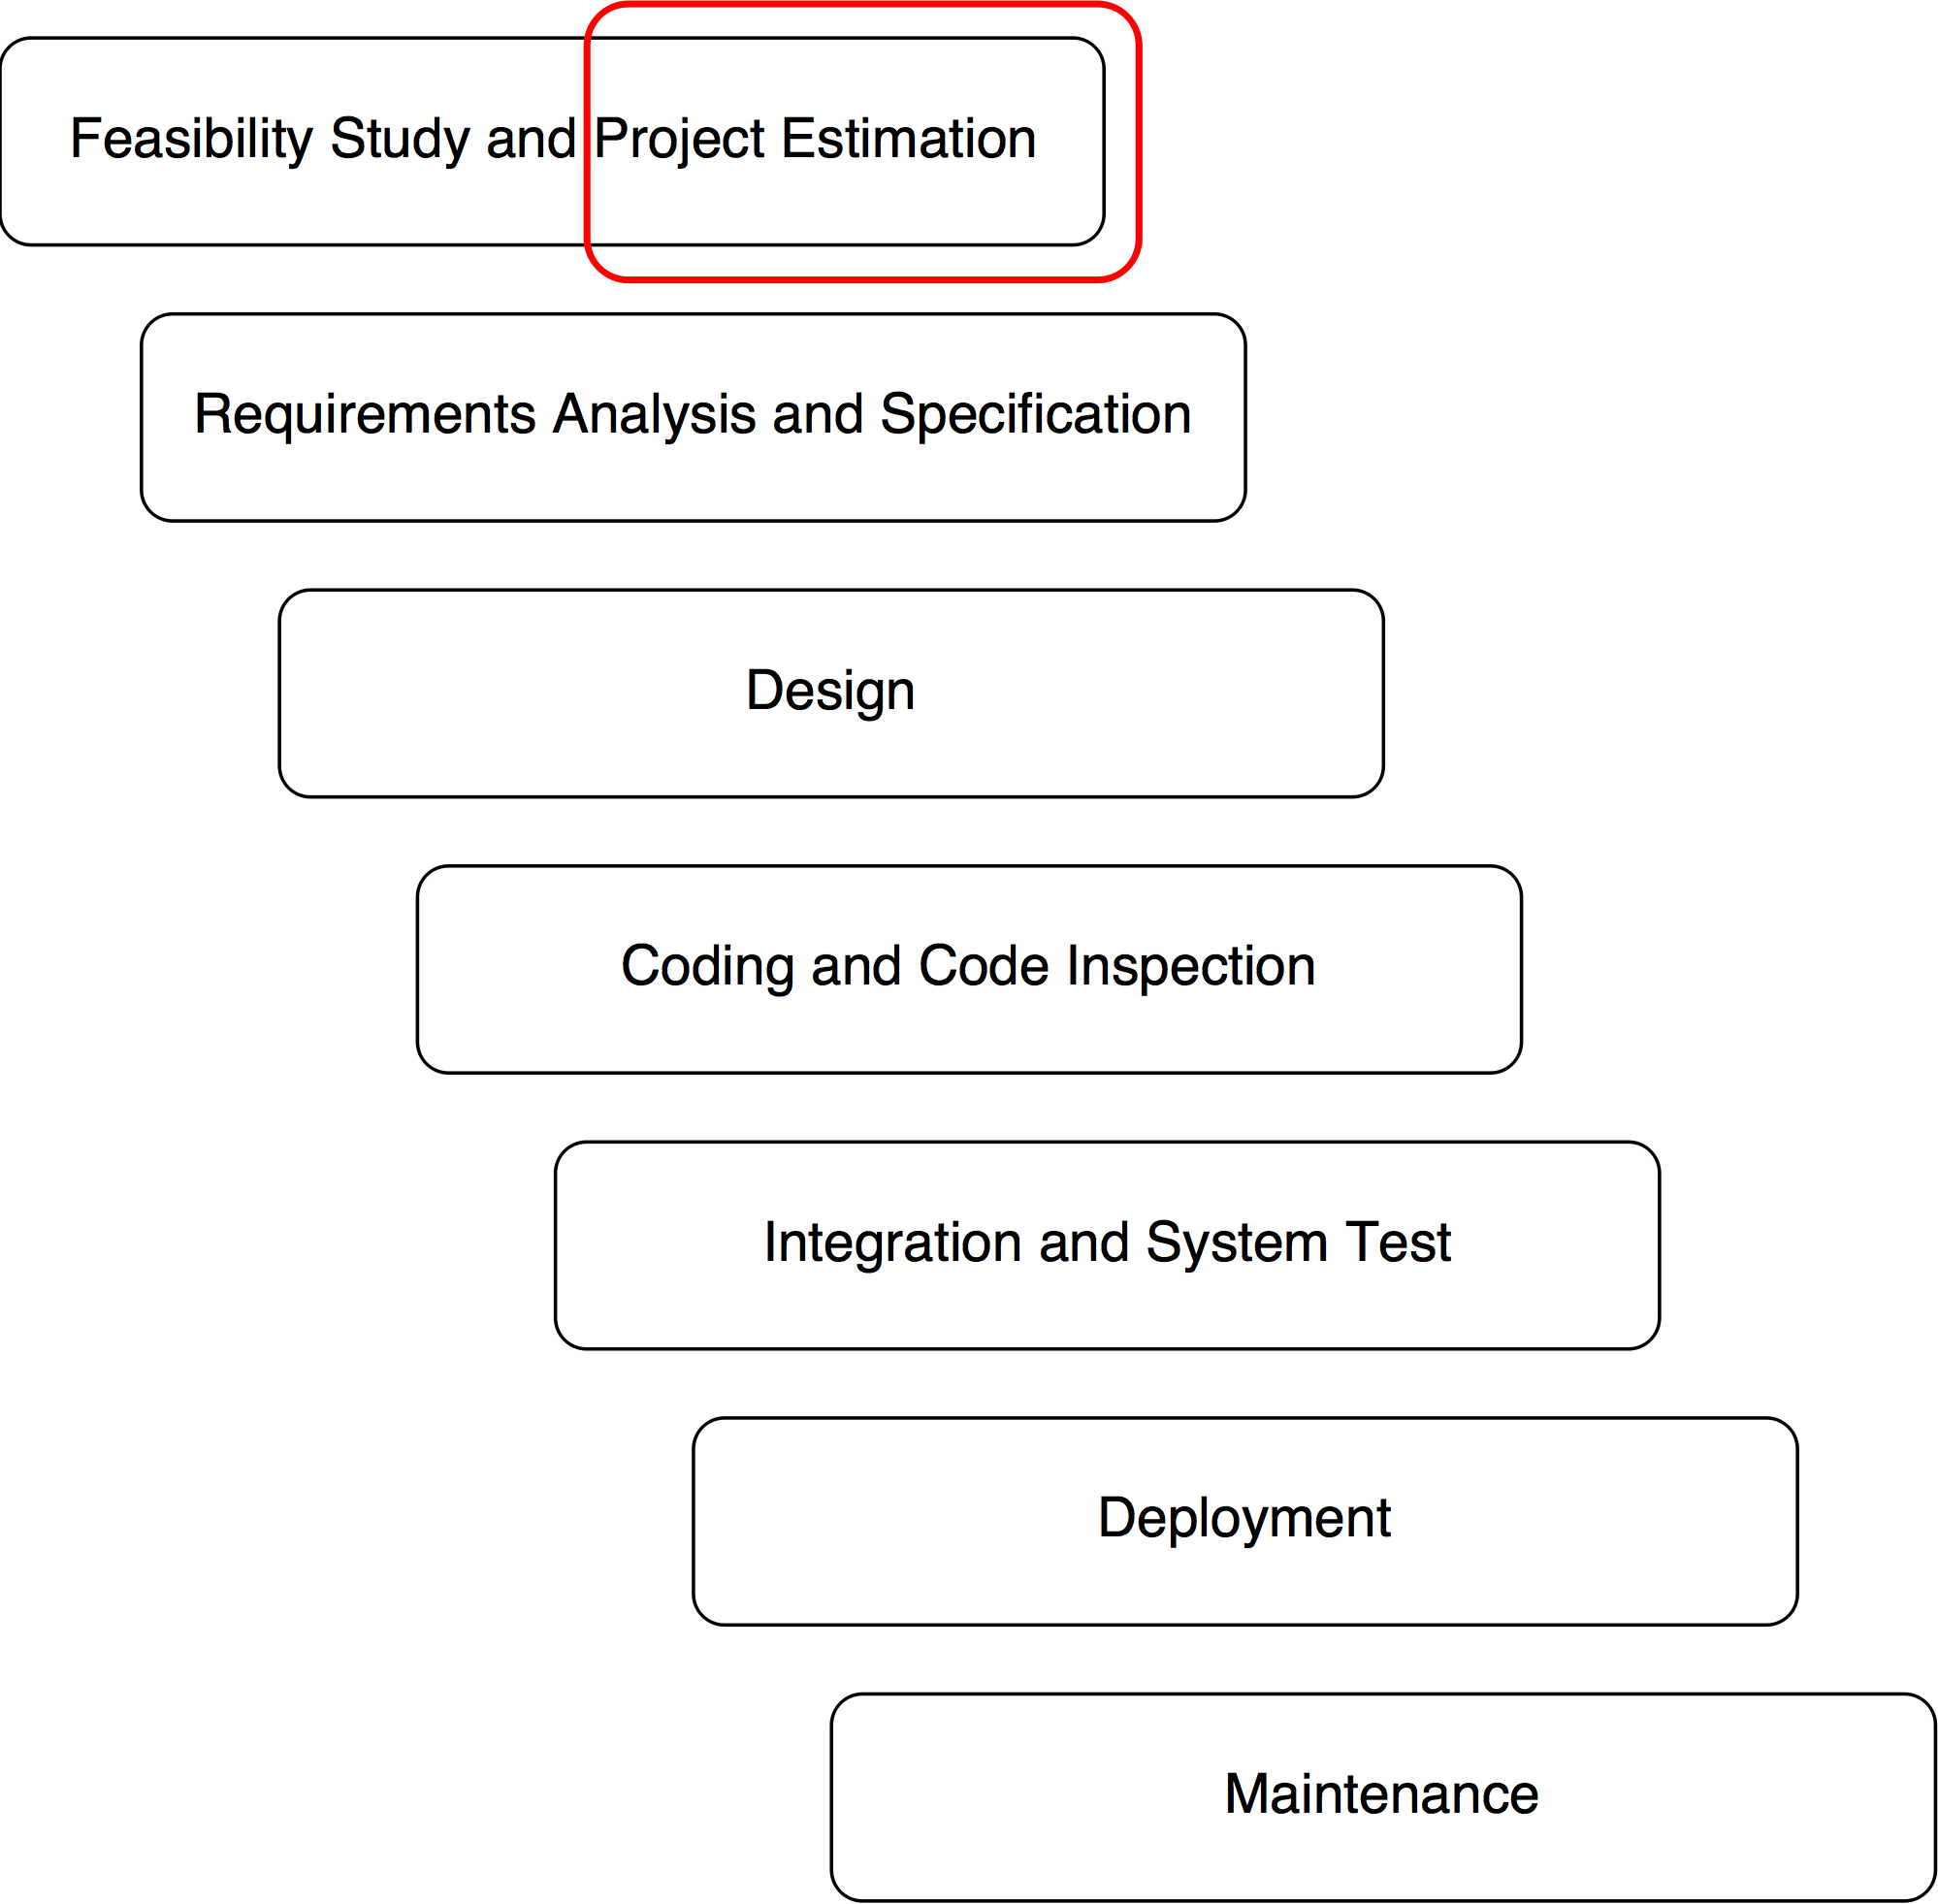
Project Plan Document
PowerEnJoy – Project Presentation
The purpose is to estimate the size, the cost and the effort required by the project.
SIZE: Function Points analysis
COST and EFFORT: COCOMO II and the related Cost Drivers and Scale Factors.
POLITECNICO DI MILANO

Slide 4
PPD – Function Points
PowerEnJoy – Project Presentation
ILFs: logical files generated and maintained by the system.
User, Car, Payment, Reservation, Ride, Safe Area…
EIFs: external interface files maintained by an external system.
Payment Information by the Payment Handler, interventions by the maintenance legacy system, maps...
EIs: elementary operations to elaborate data coming from the external environment.
Registration, Login, Update user profile, Data from sensors, Car reservation, Car Unlocking…
EOs: operations that generates data from the external environment involving elaborations of data from logic files.
E-mails notifications, general purpouse notifications, final charges…
EQs: operations that involve input and outputs without significant elaborations of logic files.
View user profile, View reservations, View power grid stations…
POLITECNICO DI MILANO

Slide 5
PPD – Function Points
PowerEnJoy – Project Presentation
The final value of UFP is 152.
Using a multiplicative factor of 46, the average number of SLOC is 6992.
Using a multiplicative factor of 67 as an upper bound, the average number of SLOC is 10184.
Both the multiplicative factors are obtained assuming JEE will be the main programming language used to develop the project.
POLITECNICO DI MILANO

Slide 6
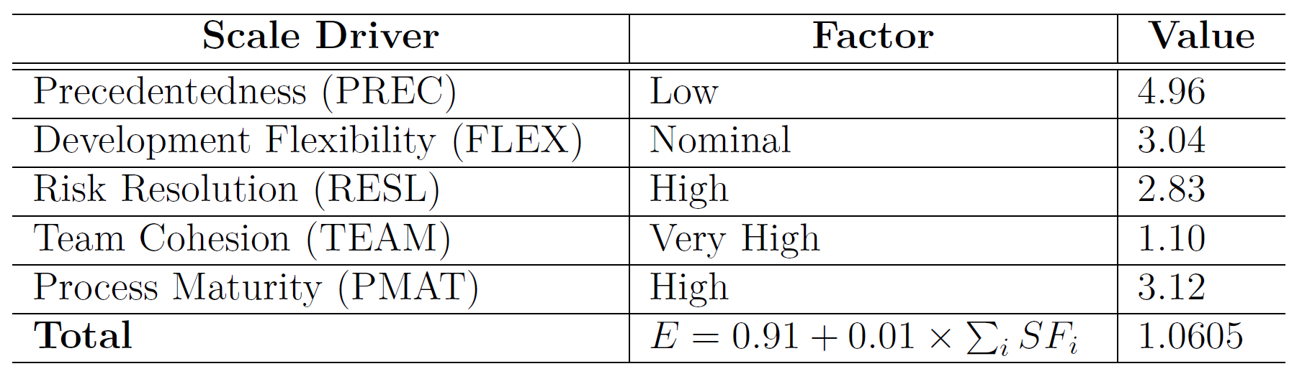
COCOMO II – Scale Drivers
PowerEnJoy – Project Presentation
The Scale Drivers reflect the non-linearity of the effort with relation to the number of SLOC.
They determine the exponent E used in the effort equation.
POLITECNICO DI MILANO

Slide 7
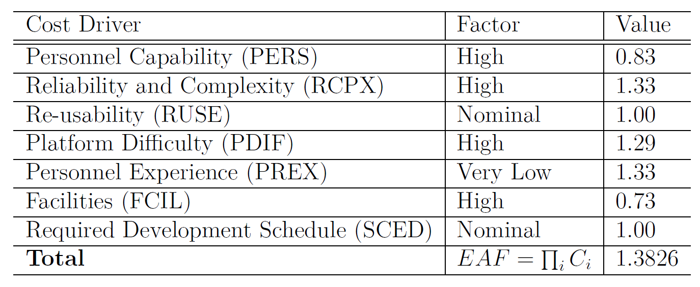
COCOMO II – Cost Drivers
PowerEnJoy – Project Presentation
Cost Drivers act as multiplicative factors on the effort needed to carry out the project.
Since we are at the beginning of the life-cycle of the project and the team is exploring and evaluating different architectural alternatives, the point-of-view will be that of the Early Design fashion of the COCOMO model.
POLITECNICO DI MILANO

Slide 8
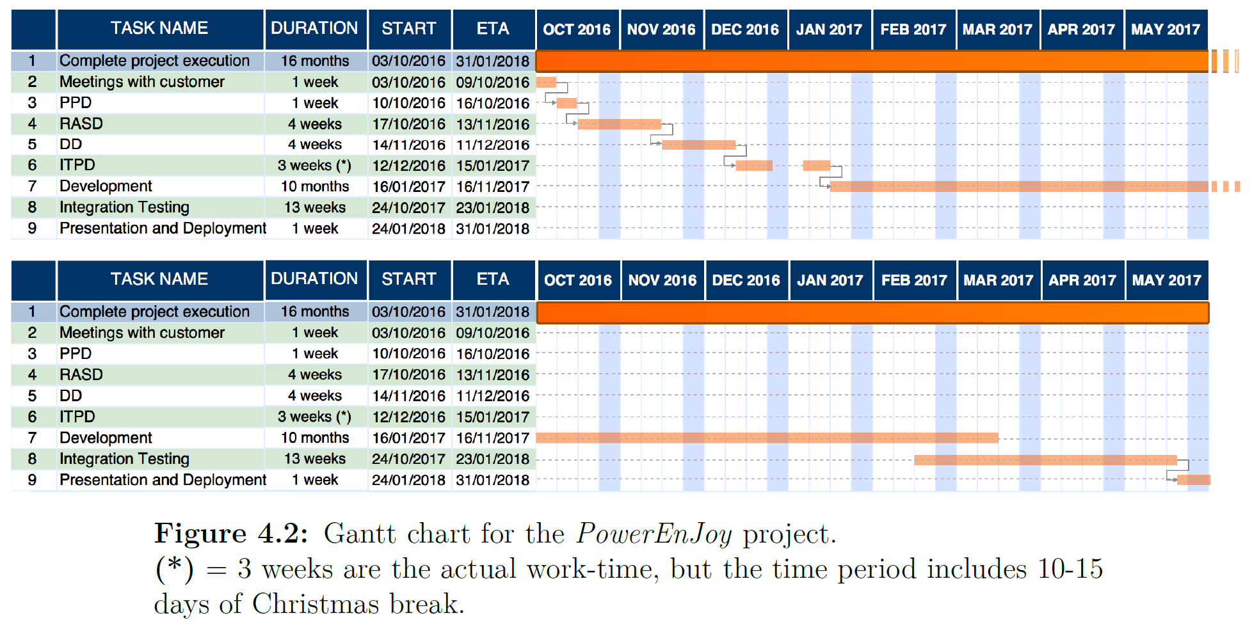
COCOMO II – Schedule Estimation
PowerEnJoy – Project Presentation
The total effort results in 31.97 person-months with an upper bound of 47.64 person-months.
Since our team is composed of 2 people, we assume an overall project duration of about 16 months.
POLITECNICO DI MILANO

Slide 9
PPD – Risks and Contingency Plans
PowerEnJoy – Project Presentation
The main risks that might threaten our project are the following:
Project Risks:
Deadlines not met: in this case a first release with the main functinalities will be offered, followed by other releases concerning less important features.
Team break-ups: to avoid this risk each team member must be valued in the same way.
Technical Risks:
Interaction with external systems: failures involving such components constitute a severe risk for our system. We must maintain a close collaboration with development teams of the partners.
Economical Risks:
Competitors: in order to avoid economical losses brought by possible competitors, we must continuously provide new appealing functionalities also based on the customer feedback.
POLITECNICO DI MILANO

Slide 10
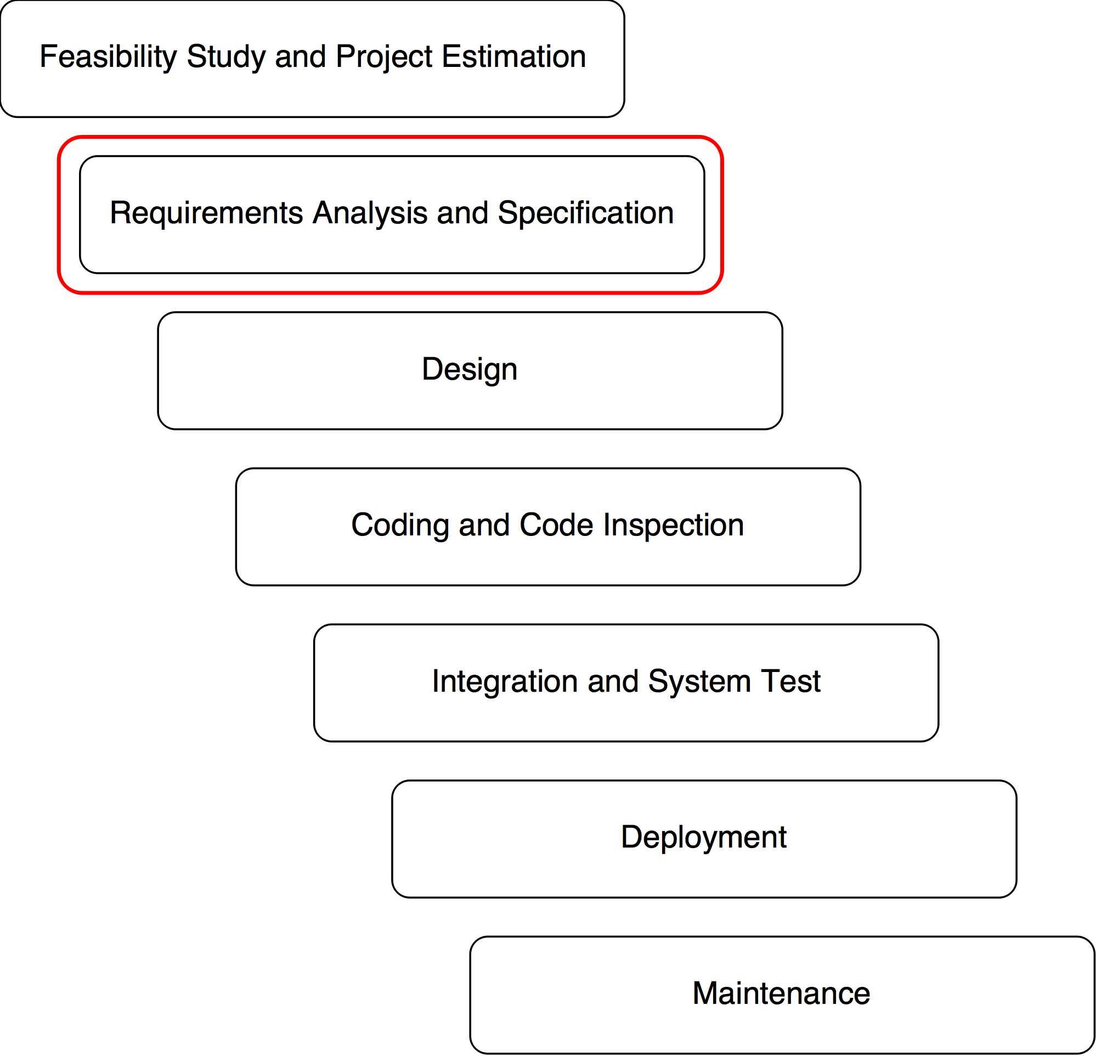
Requirements Analysis and Specification Document
PowerEnJoy – Project Presentation
«Without requirements or design, programming is the art of adding bugs to an empty text file.»
POLITECNICO DI MILANO

Slide 11
PowerEnJoy – Project Presentation
POLITECNICO DI MILANO

Slide 12
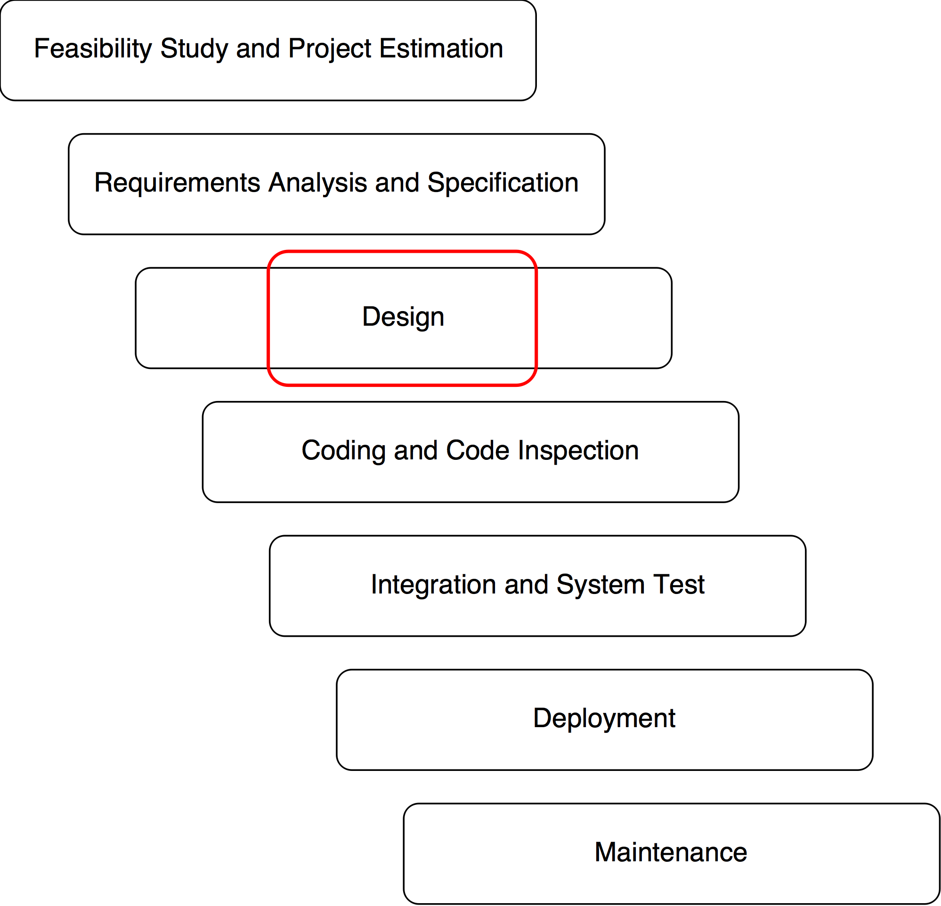
Design Document
PowerEnJoy – Project Presentation
The Design Document deals with:
Architectural design
Algorithm design
Discounts and additional charges computation
User Interface design
UX diagrams
User interface (Web, Mobile, On-Board…)
Requirements traceability
Functional and non-functional requirements
POLITECNICO DI MILANO

Slide 13
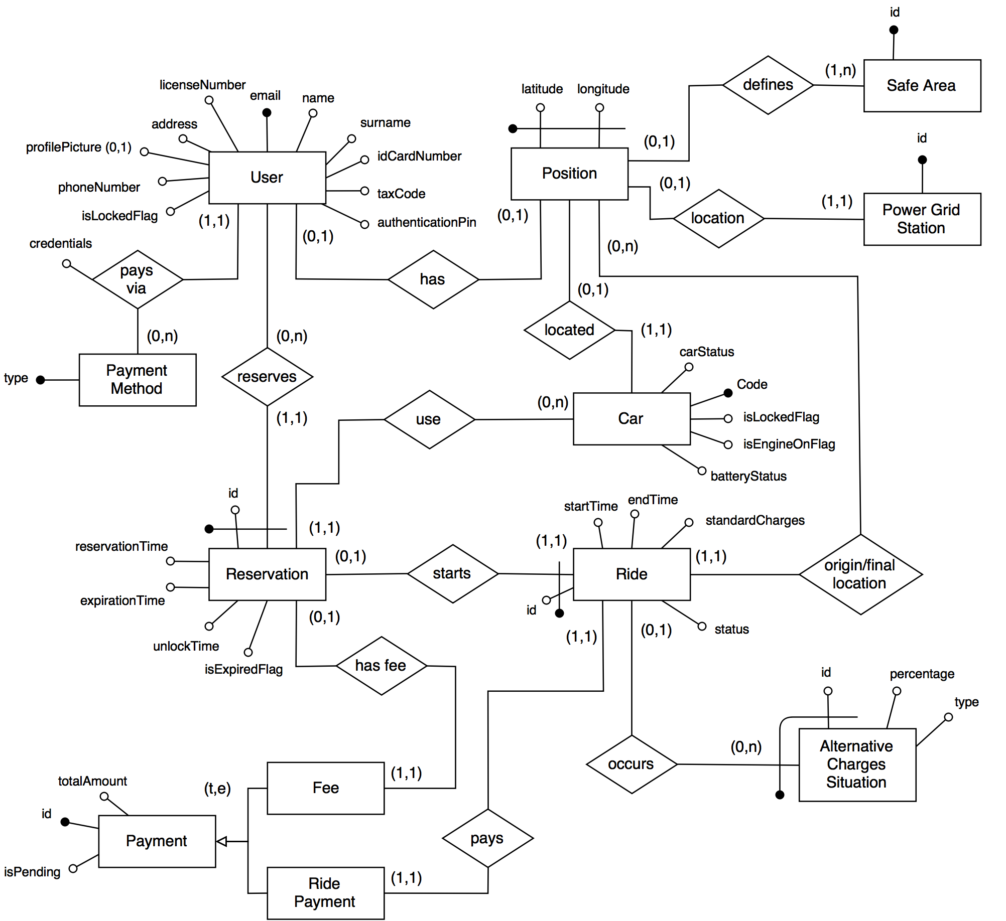
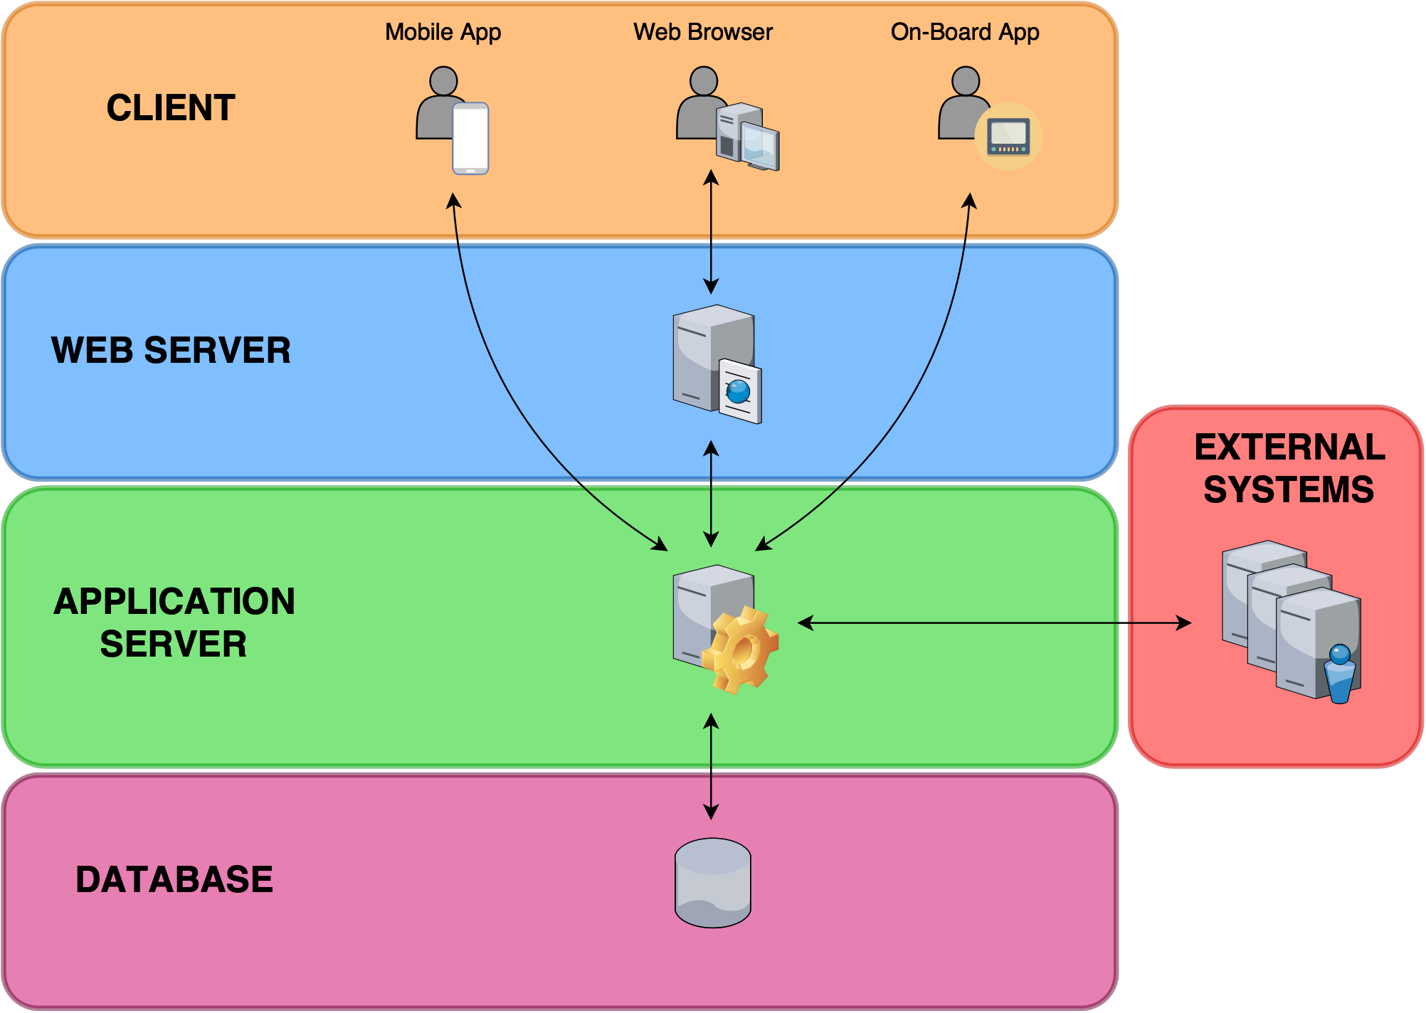
Architectural Design
PowerEnJoy – Project Presentation
Multi-tier client/server architecture. We followed a top-down design approach which led us to enrich the high level structure of the system.
Layered structure of the system
Draft of the E-R diagram
POLITECNICO DI MILANO

Slide 14
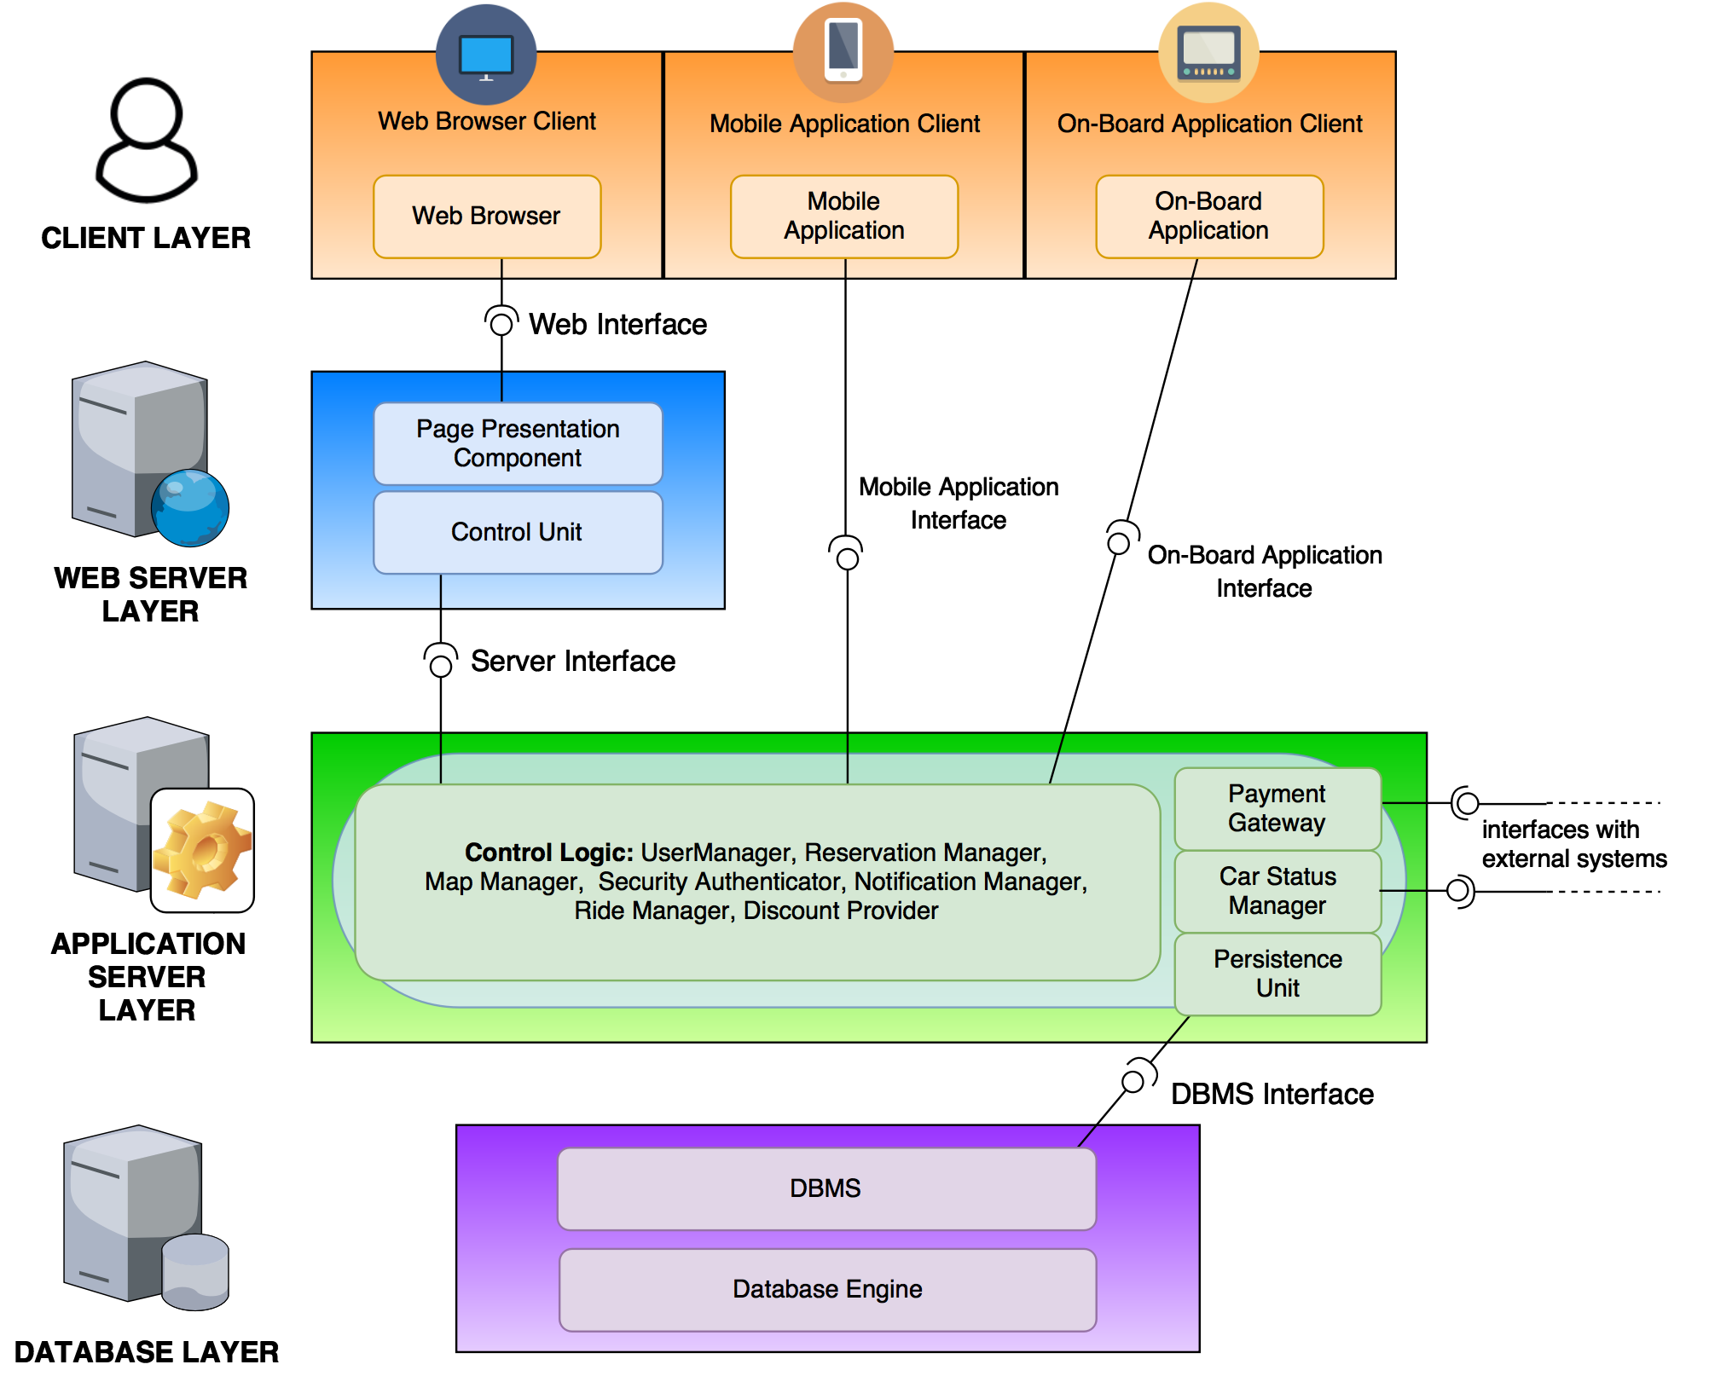
Top Down - From the general to specific…
PowerEnJoy – Project Presentation
The detailed global component view gives us a clear picture of what will be implemented using JEE technology. In particular:
The business logic modules are implemented by stateless Session Beans.
Java Perisistence API together with Entity Beans create the persistence unit in order to communicate with the Database.
The Web Server takes advantage of JSP technology to offer the presentation logic based on the MVC pattern.
POLITECNICO DI MILANO

Slide 15
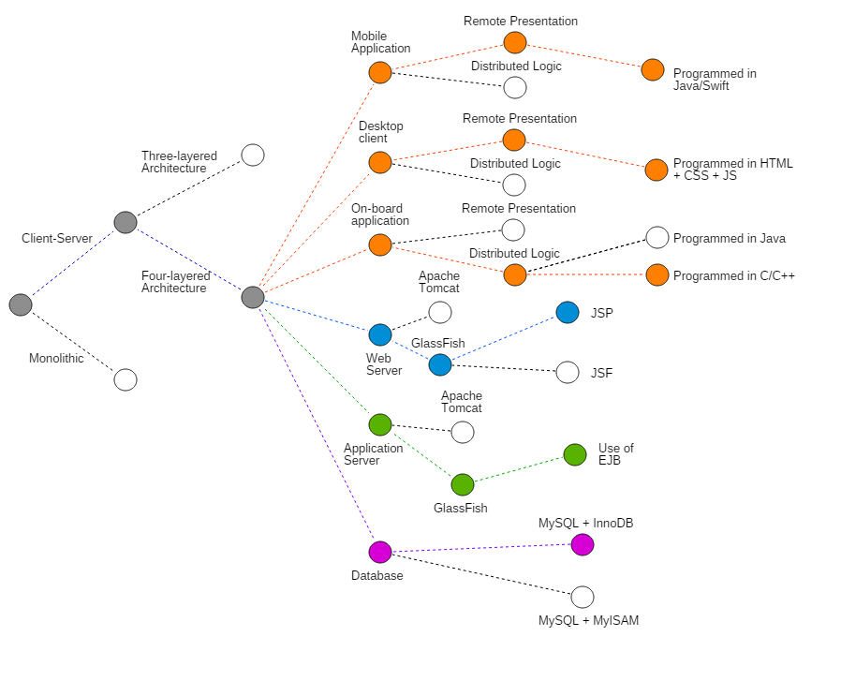
Design Decisions
PowerEnJoy – Project Presentation
Summing up…
POLITECNICO DI MILANO

Slide 16
PowerEnJoy – Project Presentation
POLITECNICO DI MILANO

Slide 17
PowerEnJoy – Project Presentation
POLITECNICO DI MILANO

